Slide 1
Automatic Scoring up of Music in Mensural Notation
Martha E. Thomae, Julie E. Cumming, Ichiro Fujinaga
Centre for Interdisciplinary Research in Music Media and Technology (CIRMMT)
McGill University
Music Encoding Conference
College Park, May 23rd, 2018
Notes:
[Next Slide Beg:] THIS TOOL IS MEANT TO WORK WITH MENSURAL MUSIC. Mensural music refers to vocal polyphonic music written between the 1250s and the 1600s, which used an older system of music notation called “mensural notation”
HERE WE HAVE an example of a mensural piece [Click!]

Slide 2
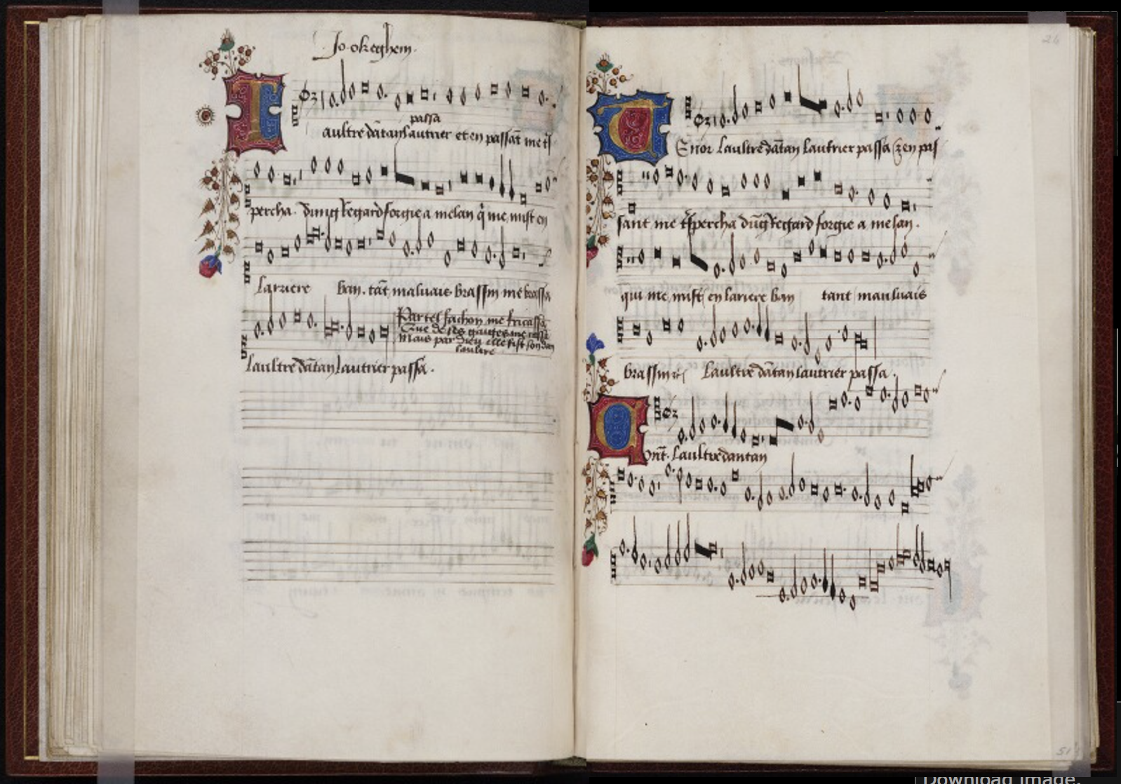
Superius
Tenor
Contratenor
Beinecke Rare Book & Manuscript Library
Mellon Chansonnier (MS 91), 25v-26r
Notes:
Most mensural music was written in separate parts
the voices are presented separately: in different areas of the page or in books
You can see that in this example
So here we have the opening of a book
That contains a single piece -> This is L’Autre D’Antan by Ockeghem -> It is a mid-fifteenth century piece
Each of the 3 voices lies on a different area of the opening
S, T, C
This separate arrangement of the voices makes it harder to analyze this music:
While you have all the melodic information of each voice
You cannot visualize the vertical sonorities that easily, because the notes are not lined-up (as will be the case if the voices were presented in score format)
The purpose of this project is to take ALL the notes from each of the mensural parts (i.e., voices) and line them up automatically [CLICK!] → TO PRESENT THE PIECE in score format

Slide 3
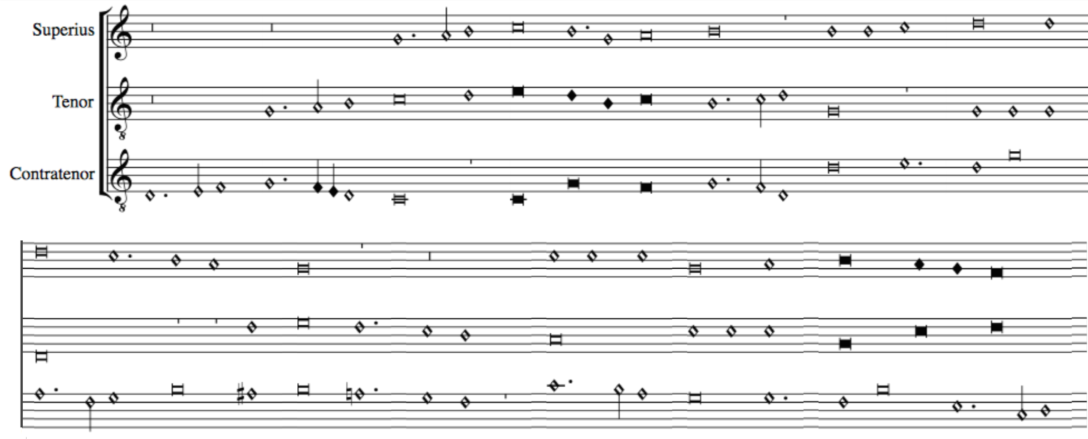
Scoring up
Notes:
TO PRESENT THE PIECE in score format
We REFER to this process as SCORING UP
We are developing an Automatic Scoring-Up Tool
To facilitate counterpoint studies (this is, the study of the relation between the voices)
So, even though the TASK of the "scoring-up tool" SEEMS PRETTY SIMPLE (just lining-up the notes of the different voices), it is COMPLICATED BY THE NATURE OF THE NOTATION ITSELF.
[CLICK!] So lets talk about mensural notation...

Slide 4
Mensural Notation (An Introduction)
Notes:
So lets talk about mensural notation..

Slide 5
Beinecke Rare Book & Manuscript Library
Mellon Chansonnier (MS 91), 25v-26r
Notes:
Mensural notation is the immediate predecessor of our Common Western Music Notation system, and when IT started, we already had an EXPLICIT way to notate PITCH:
Staff-lines
Clefs
But the same did not applied to rhythm yet.
1. We already had DIFFERENT NOTE-SHAPES as you can see here, BUT they did not EXPLICITLY conveyed the duration of the note.
2. It is COMMON to have the SAME note shape being used twice, even next to each other, and representing different durations…
3. This AMBIGUITY of the note DURATION COMPLICATES the SCORING-UP TASK, because in order to line the notes up we need to know their duration.

Slide 6
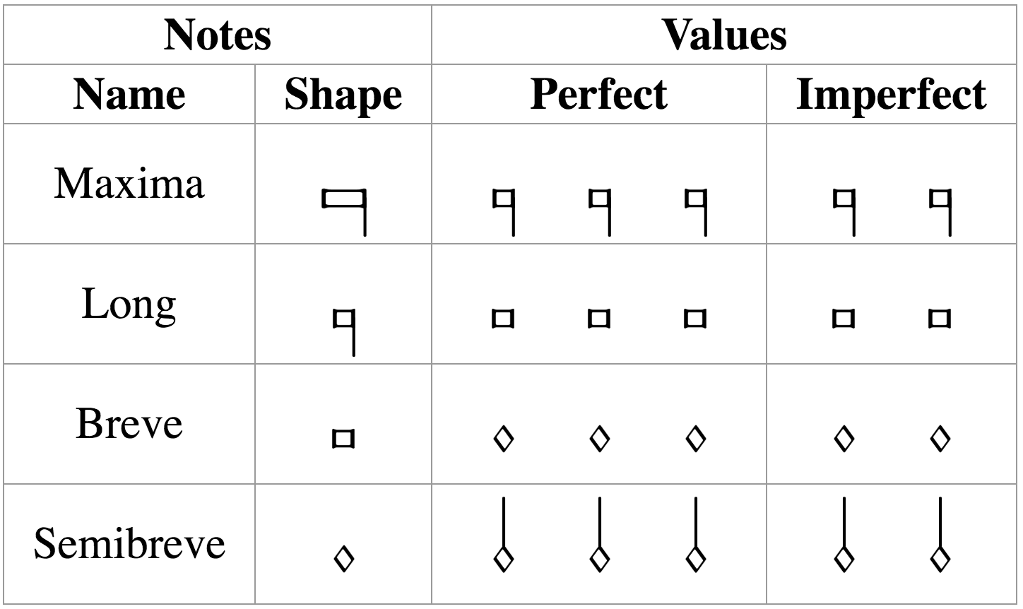
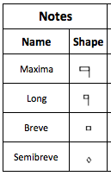

Mensural Notation
There is a clear hierarchy in the note duration
longest
shortest
Mensuration
Establishes the relation between the note values (“perfect” or “imperfect”)
3 x 2 x 1 x 3 x
Notes:
Like I said, we already have different note shapes and there is a clear hierarchy regarding the note duration
But, each note shape can have two different values, it can be ternary (perfect) or binary (imperfect).
So we have examples like ... in which (3, 2)
So, how do we know what is the value of a note?
We have this REALLY IMPORTANT concept in mensural notation: MENSURATION
So what about …? In imperfect mensuration → note-shape explicitly indicates binary value
You want to change that → to use some external (graphical) cues
JUST LIKE IN CMN: All the notes are binary, if you want to change that you use a dot or a triplet sign
--> In Mensural: binary, and to change that you use a dot called dot of augmentation which behaves the same as a Common Dotted Note (adds half of its value).
Scoring up mensural music in imperfect mensuration would be the same as scoring up common western music
So, what is the problem?
The challenge occurs when dealing with PERFECT MENSURATION at ANY OF THESE FOUR NOTE-LEVELS (it could be in the four at once). [CHANGE SLIDE]

Slide 7
In perfect mensurations, the duration of the individual note symbols is not absolute, but rather depends on context
Notes:
The MENSURATION gives us a semifixed relation between the duration of the notes, but that relation can be changed by the context (I.E., THE NOTES AROUND)
AND IT IS THIS CONTEXT-DEPENDENCY ISSUE THAT IS THE MAIN FOCUS OF THE SCORING-UP TOOL
There are certain principles on how context affects the note value. I am not going to enumerate all of these principles, but I will give an example of the general idea of on how these principles work.

Slide 8


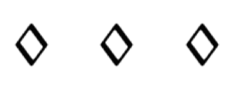


Examples of Context Changing the Note’s Duration
Mensuration: Breve = 3 → Breves are perfect by default
Principles of
Imperfection
and Alteration
Imperfection
Perfect → Imperfect
Alteration
x 2
Franco of Cologne
Ars Cantus Mensurabilis (ca. 1280)
Notes:
1. This breve is perfect, this breve is perfect, and so on…
2. That is the idea in perfect mensuration, we have this triple meter, WE MOVE IN A SERIES OF PERFECTIONS
3. [green square] Two modifications
4. [Principles!] --> Outlined by Franco of Cologne (ca. 1280)
5. Written in terms of these kinds of sequences --> delimited by notes that are supposed to be perfect --> number of notes --> modification.
6. So the scoring-up DEALS with the CONTEXT-DEPENDENT nature of mensural notation by IMPLEMENTING these PRINCIPLES of IMP and ALT

Slide 9
The Scoring-up Tool

Slide 10
Algorithm
Mensuration: Breve = 3 → Breves are perfect by default
Notes:
BOUNDING BY PAIRS OF BREVES!!!
Lets walk through the algorithm that implements these principles --> By using an example
Lets say we have the mensuration… which indicates that by default …
Steps:
1. Divide the notes into sequences of the form we saw in the previous slide.
Find all the breves
Find all the sequences that are bounded by those breves…
2. For each of those sequences we get the number of semibreves, since that will indicate the modification that we have to perform.
So lets take one of such sequences as an example

Slide 11
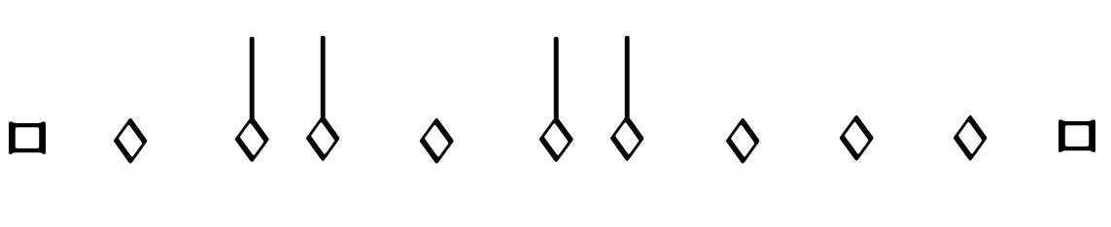
Example: (sequence bounded by breves)
1
2
3
4
5
6
7
7 semibreves = Two groups of 3 semibreves + 1
Notes:
So lets take one of such sequences as an example
So here we have 7 semibreves
And what we do is that we group those 7 semibreves into perfect groups (groups of 3 semibreves) and see HOW MANY ARE LEFT OUT
The remainder can only be 1, 2, or None

Slide 12
Number N of semibreves between the boundaries | Number P of perfect groups of semibreves | General Interpretation | Alternative Interpretation
N = 3P + 1 | P >= 0 | Imperfection (by following) | Imperfection (by preceding)
N = 3P + 2 | P = 0 | Alteration | Imperfection (by following) & Imperfection (by preceding)
 | P > 0 | Imperfection (by following) & Imperfection (by preceding) | Alteration
N = 3P | P = 0 | - | -
 | P = 1 |  | Imperfection (by following) & Alteration
 | P > 1 | Imperfection (by following) & Alteration | -
Notes:
3 Remainders
Type of modification (Imperfection, Alteration, Both, or None)

Slide 13
Number N of semibreves between the boundaries | Number P of perfect groups of semibreves | General Interpretation | Alternative Interpretation
N = 3P + 1 | P >= 0 | Imperfection (by following) | Imperfection (by preceding)
N = 3P + 2 | P = 0 | Alteration | Imperfection (by following) & Imperfection (by preceding)
 | P > 0 | Imperfection (by following) & Imperfection (by preceding) | Alteration
N = 3P | P = 0 | - | -
 | P = 1 |  | Imperfection (by following) & Alteration
 | P > 1 | Imperfection (by following) & Alteration | -
Notes:
General interpretation
Situations that do not allow for this [general] interpretation, and FORCE an alternative interpretation:
Dots of division
Rests

Slide 14
Example: (sequence bounded by breves)
1
2
3
4
5
6
7
7 semibreves = Two groups of 3 semibreves + 1
Notes:
Continuing with our example
→ General interpretation according to the previous table would be …

Slide 15
Example: (sequence bounded by breves)
1
2
3
4
5
6
7
7 semibreves = Two groups of 3 semibreves + 1
Notes:
Continuing with our example
→ General interpretation according to the previous table would be …

Slide 16
Example: (sequence bounded by breves)
1
2
3
4
5
6
7
7 semibreves = Two groups of 3 semibreves + 1
Notes:
Situations that do not allow for this interpretation, and force an alternative interpretation:
Most common one → DOTS OF DIVISION
Use to indicate that the notes belong to different perfections
Use a DOT OF DIVISION between … to indicate that they belong to different perfections
➔ So the grouping now would be

Slide 17
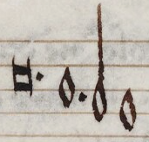
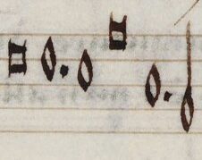
Scoring-up Tool
Deals with the context-dependent nature of mensural notation
By implementing the “principles of imperfection and alteration”
Deals with other non-context-related features:
Dots of augmentation
Coloration
When?
Distinguish between “dots of division” and “dots of augmentation”
When does coloration affect the note value?
Notes:
[START Content of the Slide]
[In Non-Context Related Features]
Dots of augmentation are …
Coloration is ...
Encoding the effect of these is not difficult
...
So, just to show you how the scoring-up tool works

Slide 18
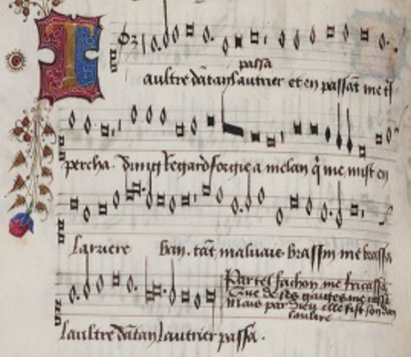
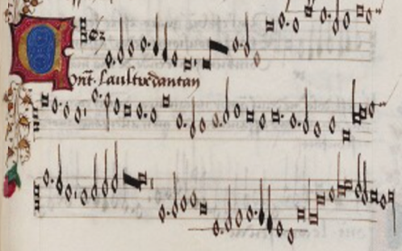
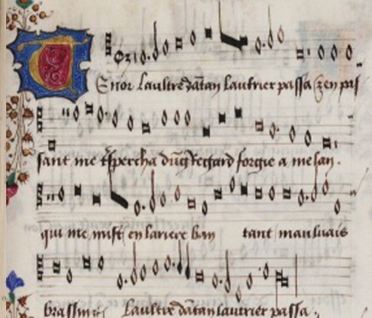
Scoring-up Tool
Mensural MEI file
________
________
Scoring-up
Tool
Mensural
MEI file
________
________
________
________
________
Superius part
Mensural MEI file
________
________
Contratenor part
SCORE
Mensural MEI file
________
________
Tenor part
Notes:
We have these Mensural MEI files encoding all the notes in each voice
Two types of information regarding the notes:
Pitch and the note-shape → @pname and @dur
ScUp --> Merges & same info as input (pitch and note-shape)
+ the modification of a note (imperfections, alterations, and augmentations).
These modifications are encoded within the <note> elements using the attributes @num and @numbase, according to the following table…

Slide 19
Scoring-up Tool
Modification | @num | @numbase
Imperfection | 3 | 2
Alteration | 1 | 2
Augmentation | 2 | 3
Notes:
3 IMPERFECT notes in the place of 2 perfect ones
1 ALTERED in the place of 2 regular
2 AUGMENTED in the place of 3 REGULARs

Slide 20
Data used for the Experiment
Pieces from the XIV and XV Centuries
Century | Project | Format | Composers and Sources | Number of Pieces
XIV | Measuring Polyphony Project (Karen Desmond) | Mensural MEI | Vitry, Machaut, Anonymous (Ivrea Codex) | 8
XV | Josquin Research Project (Jesse Rodin, Craig Sapp, Clare Bokulich) | Modern transcriptions converted into Mensural MEI using: SibMEI + Mensural MEI Translator | Du Fay and Ockeghem (GB-Ob, Dijon, Mellon, Laborde, Wolfenbüttel) | Du Fay: 5 Ockeghem: 5
Notes:
Accuracy, in average: 97%
Calculated over all the notes that are subject to modification (by imperfection, alteration, followed by a dot, and coloration)

Slide 21
Example: Three Separate Parts
Notes:
15th Century OCKEGHEMS’ piece (L’autre D’antan)
Parts
This is how they look like when rendered in Verovio
Barlines → places where the voices must coincide (PERFECT GROUPINGS!)

Slide 22
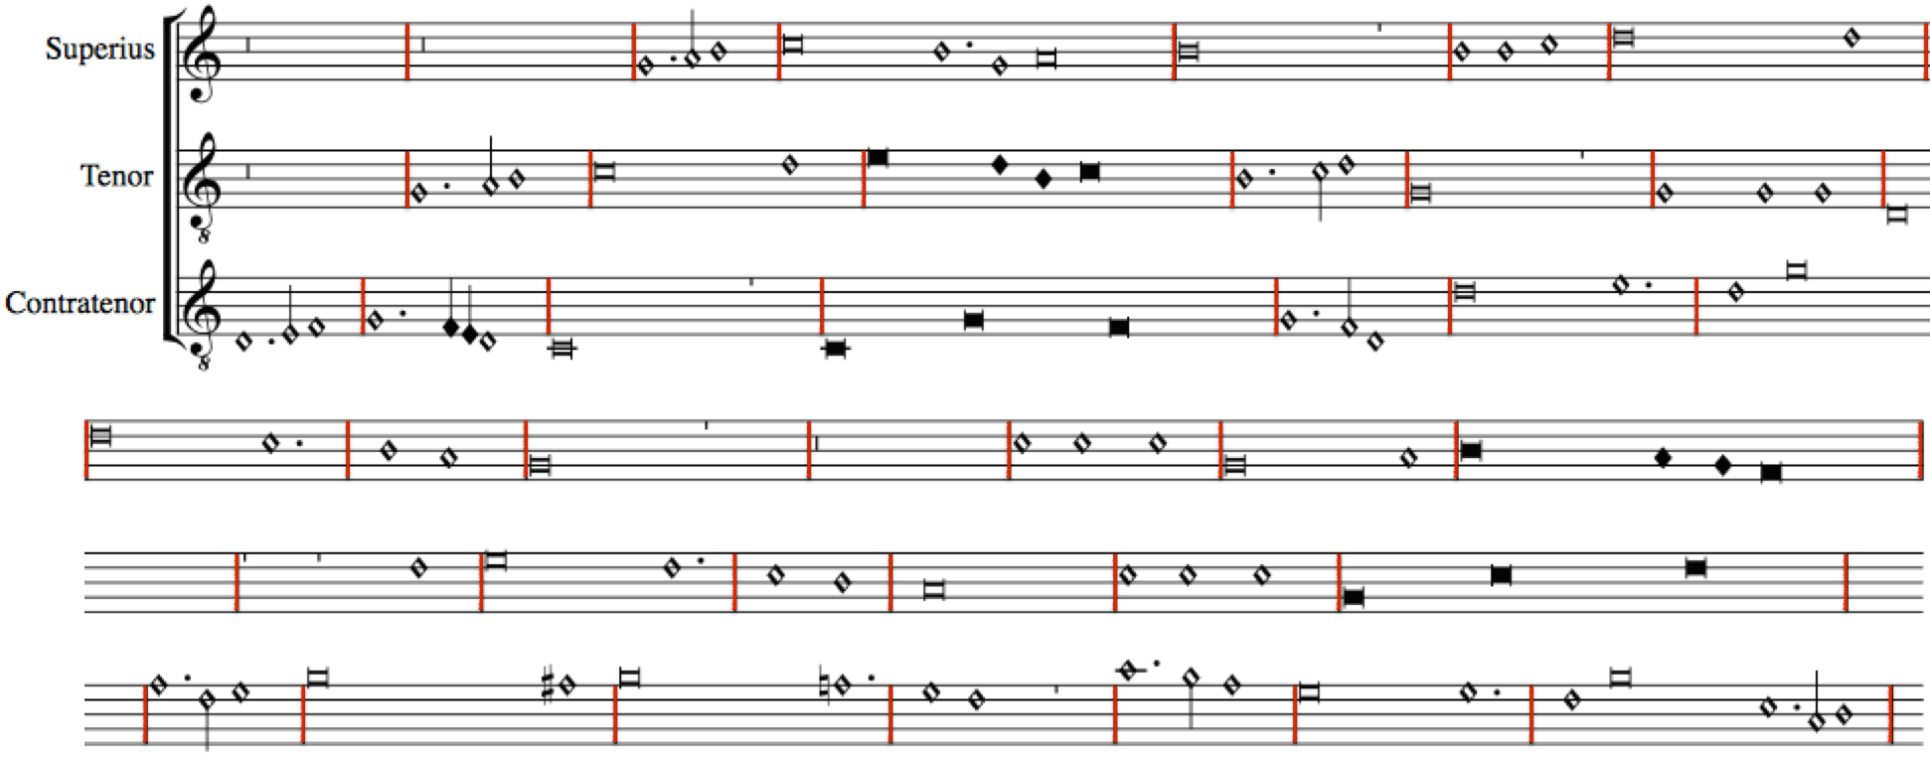
In Quasi-Score Format – Without Scoring-up Tool (notes are not aligned)
Notes:
Say the ”DURATION stuff” HERE TOO
VEROVIO INTERPRETS ALL NOTES AS HAVING THE DURATIONAL VALUE GIVEN BY THE MENSURATION
UNLESS, THE MODIFICATION ON THE DURATION OF A NOTE IS ENCODED WITHIN THE NOTE
WHICH IS WHAT THE SCORING-UP TOOL DOES.
WE NEED TO ENCODE THE EFFECT OF THAT MODIFICATION
THIS IS, WE NEED TO ENCODE THE MODIFIED DURATION.

Slide 23
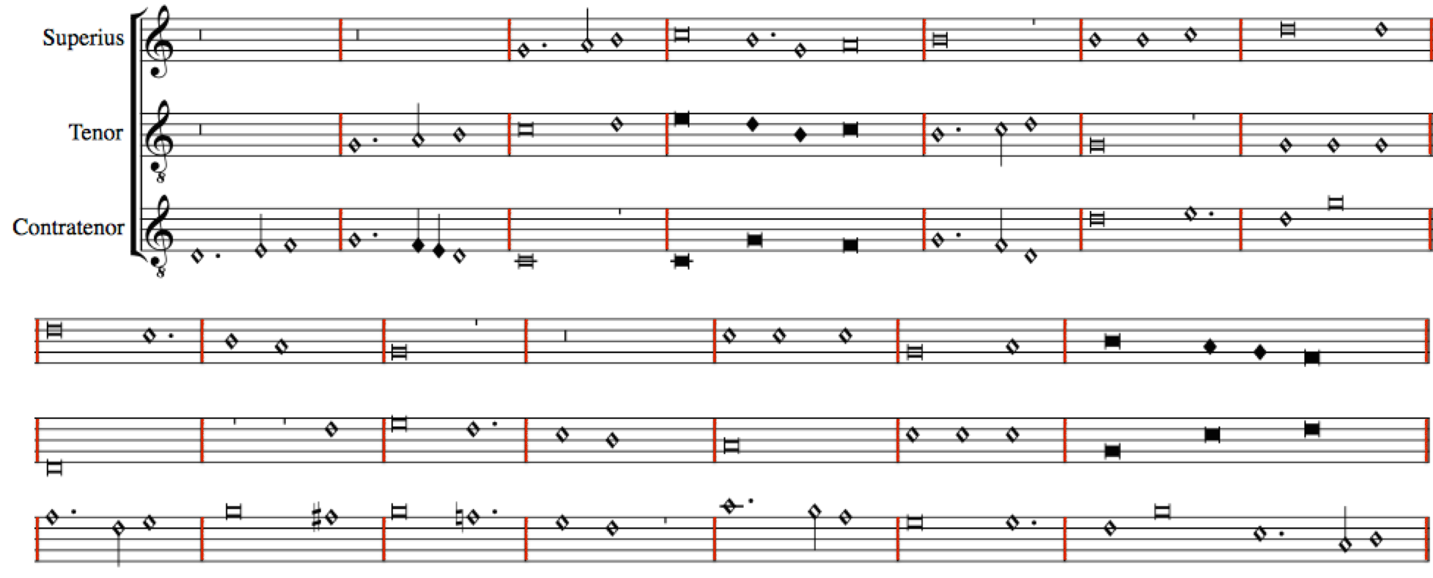
In Score Format – With Scoring-up Tool (modification values encoded)
Notes:
Show here:
The Imperfections
The Alterations
The coloration
The distinct dots

Slide 24
Conclusions
Preserves the original note values
The scoring-up tool presents the piece in score format
Facilitates visualizing the vertical sonorities and studying the relation between the voices of a piece
Future work…
Notes:
[After 2] which is obscured by the separate-parts layout of the original sources
[After 3] Making it faithful to the source, while providing additional information (regarding the vertical sonorities)

Slide 25
Superius
Mensural MEI file
________
________
Scoring-up
Tool
OMR
Superius part
Mensural
MEI file
________
________
________
________
________
Contratenor
Mensural MEI file
________
________
OMR
Contratenor part
Tenor
Mensural MEI file
________
________
SCORE
OMR
Tenor part
Notes:
Meant to be the second part of a larger workflow
In which the first part consist on performing Optical Music Recognition on a set of mensural pieces,
From which we would obtain the Mensural MEI files encoding each voice. These files capture only the information present in the sources (this is, pitch and note symbols)
These are the input files of the Scoring-up, which finds the durational values of all the notes within these files based on contextual and non-contextual cues and returns the Mensural MEI file encoding the score.

Slide 26
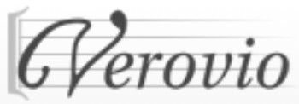
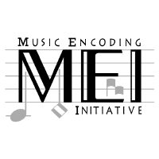
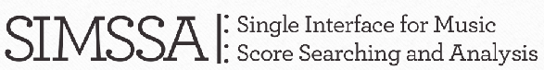

Thank you! https://github.com/elvis-project/scoring-up

